Slide 1
Contrast Stretching
Submitted by:
Anupam Sudhakaran – 20BCI0133
Rishabh Acharya – 20BCI0131
Sanjana Awasthi – 20BCI0120

Slide 2
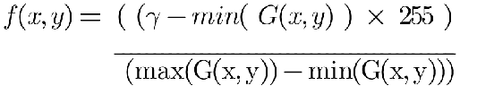
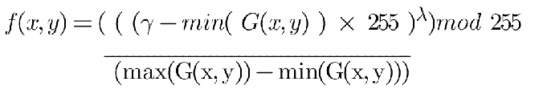
Mathematical Function
Base Function
Updated Function
Where,
f(x,y) is image after operation
G(x,y) is the image

Slide 3
Code for Base Function
for i in range(n):
for j in range(m):
img[i,j][0]=(((img[i,j][0]-funct_min(img,i,j,0))/(funct_max(img,i,j,0)-funct_min(img,i,j,0)))*255)
img[i,j][1]=(((img[i,j][1]-funct_min(img,i,j,1))/(funct_max(img,i,j,1)-funct_min(img,i,j,1)))*255)
img[i,j][2]=(((img[i,j][2]-funct_min(img,i,j,2))/(funct_max(img,i,j,2)-funct_min(img,i,j,2)))*255)

Slide 4
Code for Updated Function
for i in range(n):
for j in range(m):
img[i,j][0]=((((img[i,j][0]-funct_min(img,i,j,0))/(funct_max(img,i,j,0)-funct_min(img,i,j,0)))*255)**0.9)%255
img[i,j][1]=((((img[i,j][1]-funct_min(img,i,j,1))/(funct_max(img,i,j,1)-funct_min(img,i,j,1)))*255)**0.9)%255
img[i,j][2]=((((img[i,j][2]-funct_min(img,i,j,2))/(funct_max(img,i,j,2)-funct_min(img,i,j,2)))*255)**0.9)%255

Slide 5
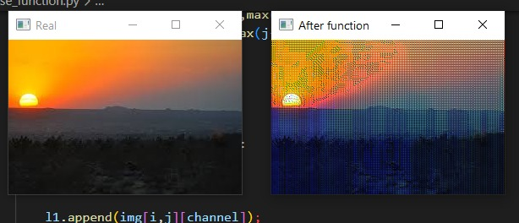
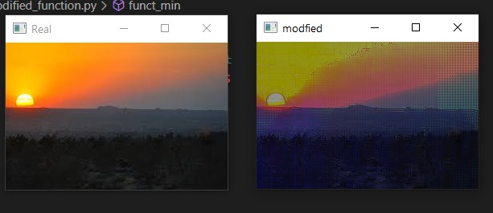
Output Images before and after mathematical updation
Base function
Updated function

